Slide 1
GRAPH TRAVERSAL

Slide 2
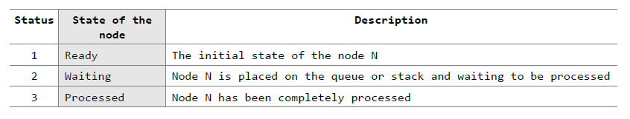
GRAPH TRAVERSAL ALGORITHMS
There are two standard methods of graph traversal .
Breadth-first search 2. Depth-first search
breadth-first search uses a queue as an auxiliary data structure to store nodes for further processing,
depth-first search scheme uses a stack.
Both these algorithms make use of a variable STATUS.
During the execution of the algorithm, every node in the graph will have the variable STATUS set to 1, 2 or 3, depending on its current state.

Slide 3
Breadth-First Search
Breadth-first search (BFS) is a graph search algorithm
that begins at the root node and explores all the neighboring nodes.
Then for each of those nearest nodes, the algorithm explores their unexplored neighbor nodes, and so on, until it finds the goal.
Steps
We start examining the node A and then all the neighbors of A are examined.
Next, we examine the neighbors of neighbors of A, so on and so forth.
This means that we need to track the neighbors of the node and guarantee that every node in the graph is processed and no node is processed more than once. This is accomplished by using a queue that will hold the nodes that are waiting for further processing and a variable STATUS to represent the current state of the node.

Slide 4
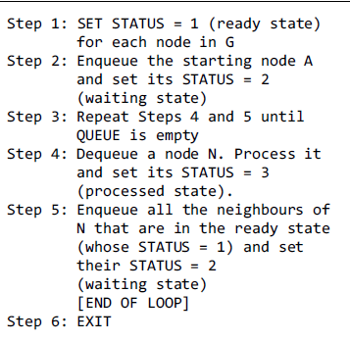
Breadth-First Search Algorithm

Slide 5
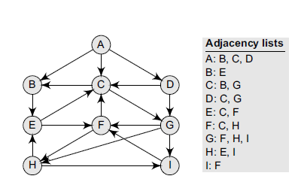
The adjacency list of G is also given. Assume that ➔ G represents the daily flights between different cities ➔ we want to fly from city A to I with minimum stops. find the minimum path P from A to I given that every edge has a length of 1.
Consider the graph G given in Figure

Slide 6
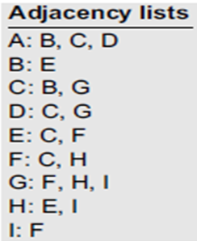
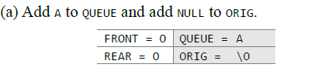
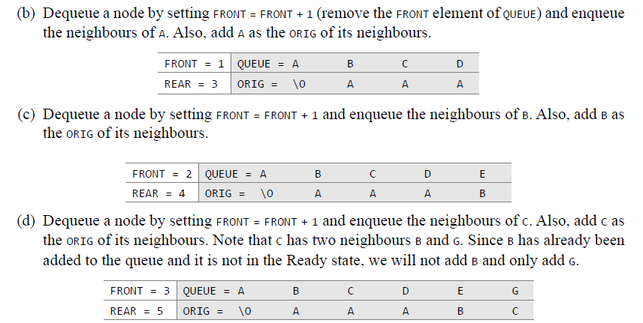

Slide 7
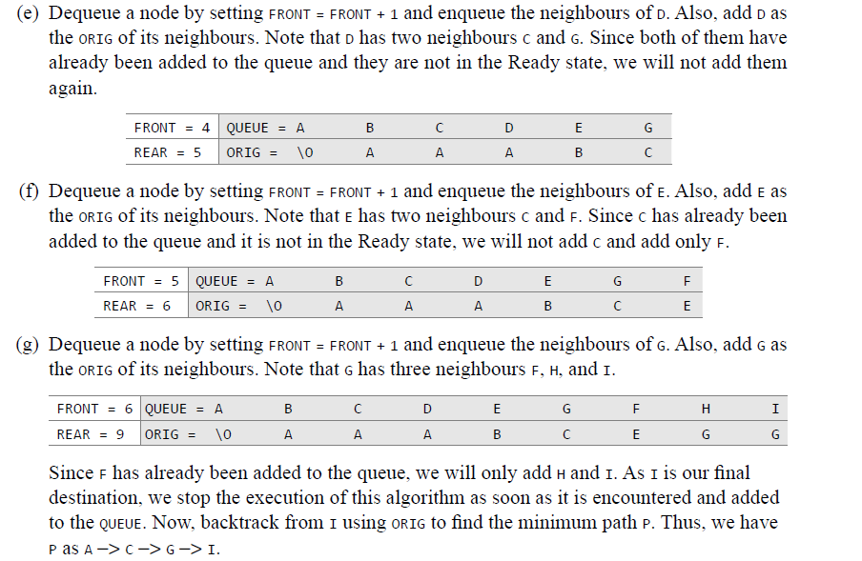

Slide 8
Find the order of execution of nodes in BFS
A B C D E G F H I

Slide 9

Find the path from A to C

Slide 10
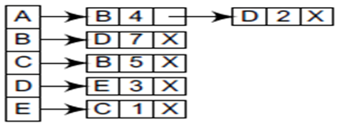
Find the path from A to C
Index | 0 | 1 | 2 | 3 | 4
Vertex | A | B | D | E | C
Pred. | /0 | A | A | D | E
STA=2 | 2 | 2 | 2 | 2 | 2
STA=3 | 3 | 3 | 3 | 3
Front | 0 | 1 | 2 | 3 | 4
Rear | 0 | 2 | 2 | 3 | 4
A -> D -> E -> C
2 + 3 + 1 = 6

Slide 11
Applications of Breadth-First Search Algorithm
Breadth-first search can be used to solve many problems such as:
Finding all connected components in a graph G.
Finding the shortest between two nodes, u and v, of an unweighted graph.

Slide 12
Depth-First Search

Slide 13
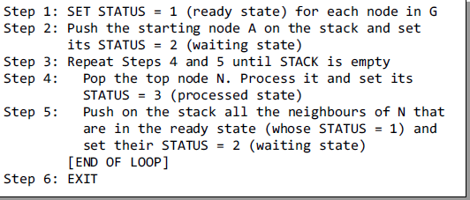
Depth-first Search Algorithm

Slide 14
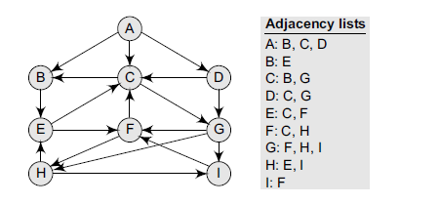
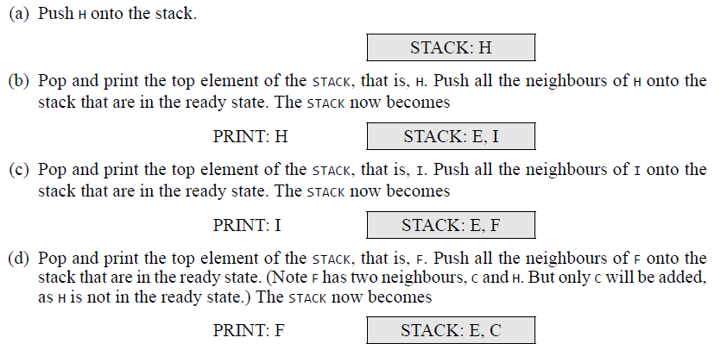

Slide 15
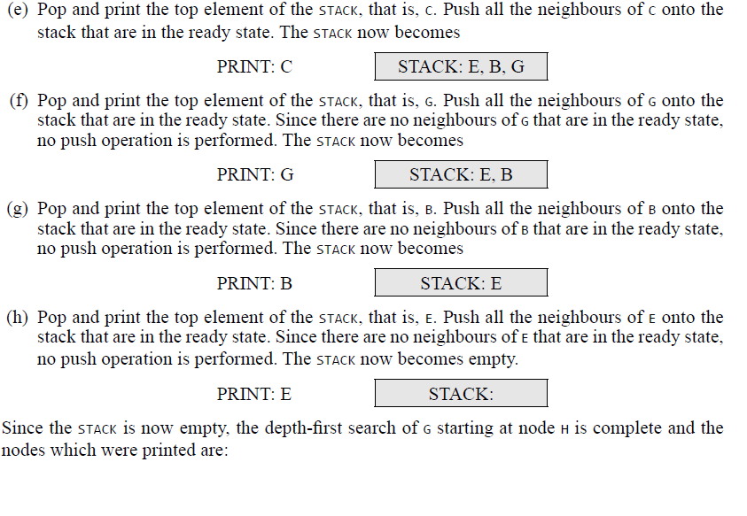


Slide 16
STACK
 |  |  |  | G
 | I | F | C | B | B
H | E | E | E | E | E | E
Vertex | A | B | C | D | E | F | G | H | I
STA-1 | 1 | 1 | 1 | 1 | 1 | 1 | 1 | 1 | 1
STA-2 |  | 2 | 2 |  | 2 | 2 | 2 | 2 | 2
STA-3 |  | 3 | 3 |  | 3 | 3 | 3 | 3 | 3

Slide 17
Applications of Depth-First Search Algorithm
Depth-first search is useful for:
Finding a path between two specified nodes, u and v, of an unweighted and weighted graph.
Finding whether any vertex is reachable or not.
Computing the spanning tree of a connected graph.

Slide 18

Use BFS and DFS to traverse the graph

Slide 19
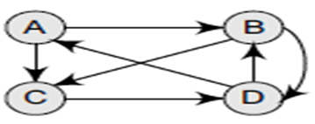
Use BFS and DFS to traverse the graph

Slide 20
Video Lectures on
BST & TBT can be found at following link
Binary Search Tree – Fundamentals
https://youtu.be/-6IqGvzUUTc
How to Perform Search & Insert Operation in Binary Search Tree (BST)
https://youtu.be/smE0gHcd5Gg
How to Delete Node in Binary Search Tree
https://youtu.be/ad1KFYHZyMc
Threaded Binary Tree – Fundamentals
https://youtu.be/e_IliqHYIu8
Adding Node in Threaded Binary Tree
https://youtu.be/dbXrAL_gBUY
Deleting a Node in Threaded Binary Tree
https://youtu.be/xexyg4XfgJg

Slide 21
Video Lectures on Graphs can be found at following link
Graphs in Data Structures
https://youtu.be/5F6EGkM11M8
Finding Transitive Closure of Graph
https://youtu.be/3d-aVMItpTs
Graph representation in Computer's memory
https://youtu.be/lVxOlVnYL-8
Breadth First Search (BFS) Traversal Algorithm
https://youtu.be/7U9l4C4Qvlo
Depth First Search (DFS) Traversal Algorithm and Example
https://youtu.be/Zb5Iagxs6Og

